Slide 1
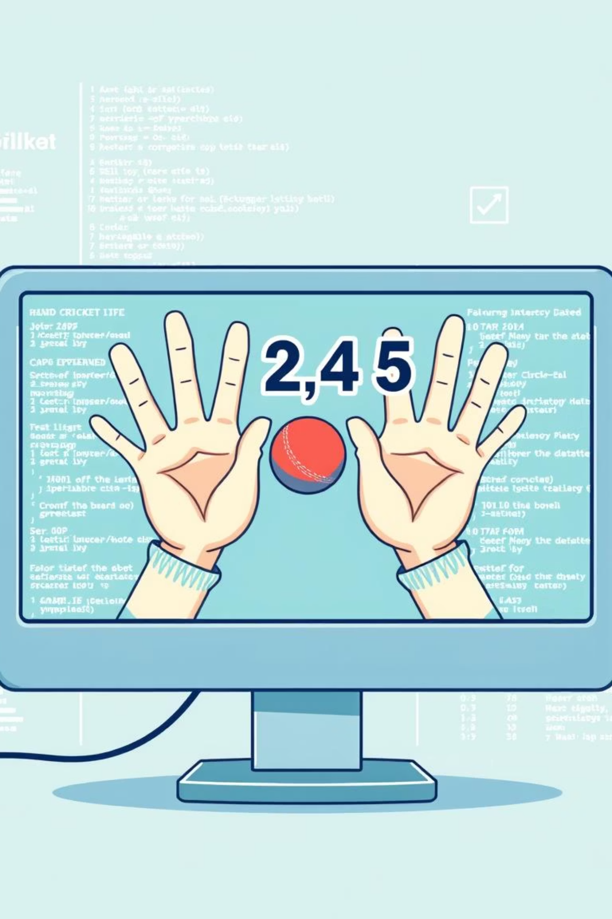
Building a Hand Cricket Game with Python & Tkinter
Welcome to an exciting journey into game development! This presentation explores how we can recreate the popular indoor game of hand cricket using Python and its Tkinter library. It's a fantastic way for beginners to dive into GUI programming and understand game logic in a fun, interactive manner.
TEAM MEMBERS
M.Nilesh (037)
P.Vigna reddy (038)
Y.Vivek (045)
S.Koshik (047)
B.Chiranjeevi (051)

Slide 2


Presentation Overview
The Challenge
Our Approach
Understanding the need for an interactive, educational project.
Outlining the development process and chosen methods.
Key Tools
Game Walkthrough
Identifying the technologies that power our game.
Exploring features, implementation, and outcomes.
The Problem: Crafting an Engaging Digital Hand Cricket Experience
The core challenge was to transform a dynamic, unpredictable physical game like hand cricket into a digital format. This required simulating its core mechanics—the random selection of "runs" by both players and the determination of wickets—while maintaining an engaging and fair user experience.
Beyond just recreation, the project aimed to serve as an accessible and instructive learning tool for Python enthusiasts. It needed to demonstrate fundamental GUI development principles and game logic in a way that was both simple to grasp and exciting to build.

Slide 3
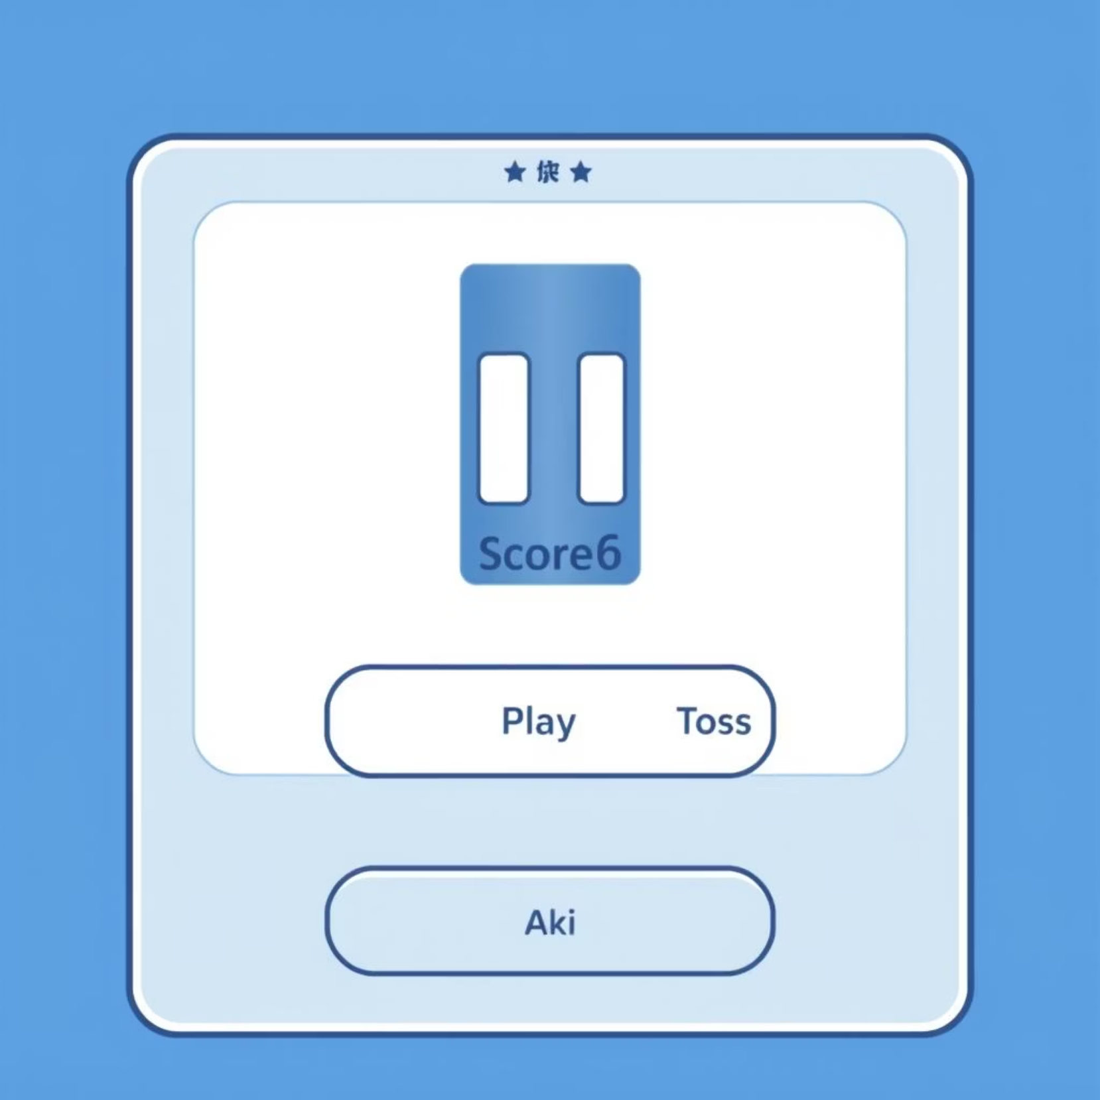
The Solution: A Python Tkinter Hand Cricket Game
Our solution is a robust Hand Cricket game built using Python and the Tkinter library. This digital adaptation successfully captures the essence of the real game, offering a complete match experience from start to finish.
Key components of the game include a precise toss system to determine batting or bowling, automated score tracking for both innings, and a clear declaration of results (win, loss, or tie). The game’s intuitive GUI ensures a smooth and enjoyable user journey, making complex game mechanics feel effortless.

Slide 4




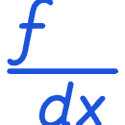
Tools & Technologies Powering the Game
Python
Tkinter
Random Module
The primary programming language, chosen for its simplicity and vast libraries, making it ideal for rapid prototyping and game logic implementation.
Python's standard GUI toolkit, used to create the interactive and visually appealing game interface. Its ease of use was crucial for this project.
Utilized to introduce unpredictability for the toss and game moves, simulating the randomness of a real hand cricket match.
Time Module
Math Module
Employed for managing delays in game actions, enhancing the user experience by controlling the pace of gameplay and visual updates.
Used for any necessary mathematical operations, particularly for calculating scores or setting targets, ensuring accuracy in game statistics.

Slide 5
Key Features: An Interactive Gaming Experience
Dynamic Toss System
1
A fair digital coin toss to decide who bats or bowls first, just like the real game.
Single Over Gameplay
2
Each player gets a designated number of balls (an over) to score, keeping the game concise and exciting.
Automatic Scoring
3
The game automatically tracks runs and wickets, eliminating manual calculation and potential errors.
Target Setting
4
For the second innings, a clear target is displayed, adding strategic depth and competitive challenge.
Interactive GUI
5
User-friendly buttons and real-time score displays keep players engaged and informed throughout the match.

Slide 6
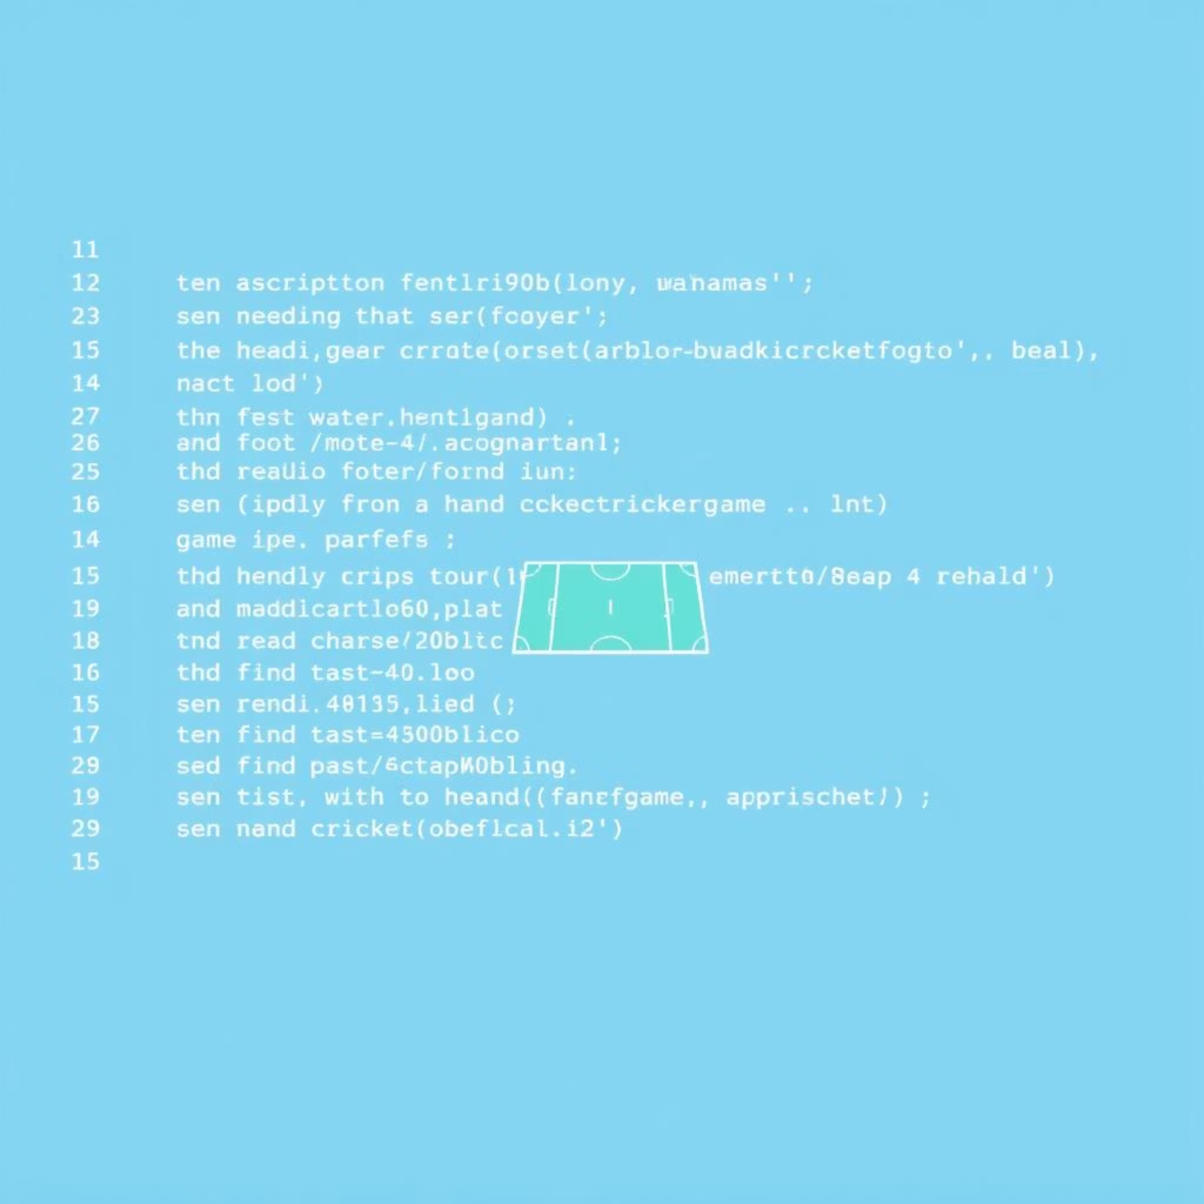
Behind the Scenes: Game Logic and GUI Integration
* The game’s implementation required meticulous coding of the core game logic.
* It covered the entire flow of play, from the initial toss mechanism to the batting and bowling phases.
* Every decision in the game, whether from a player’s input or the computer’s move, is managed by algorithms.
*The algorithms were designed to simulate the unpredictability of hand cricket, making the gameplay realistic.
# Example of a simplified game logic snippet def play_ball(player_choice): computer_choice = random.randint(1, 6) # Logic to check for wicket or add runs # Update GUI elements like score, commentary

Slide 7



Real-Time Action: Game Outputs and User Experience
Dynamic Interface
Live Scoring
Decisive Results
Screenshots demonstrate the clean layout, featuring clearly visible scorecards and interactive buttons that guide the player through the game flow.
Witness the real-time update of scores, runs, and wickets, ensuring players are always aware of the game's progression and their current standing.
The game culminates in a clear declaration of the winner, or a tie, providing a satisfying conclusion to each match. Visual cues highlight the outcome.
The game operates end-to-end, offering a complete and intuitive experience. From the initial toss to the final ball, every interaction is designed to be seamless, providing users with a truly immersive hand cricket simulation directly on their computer screens.

Slide 8




Navigating the Bumps: Development Challenges & Solutions
State Transitions
Managing the flow between game states (toss, innings 1, innings 2, result) was complex. We implemented a state machine approach to ensure smooth, logical progression.
Fair Randomness
Ensuring truly random and unbiased outcomes for the toss and game moves required careful seeding and testing of the `random` module to prevent predictable patterns.
GUI Synchronization
Keeping the GUI updated in real-time with game logic posed challenges. We optimized event handling and Tkinter `after()` methods for seamless visual updates.
Bug Resolution
Debugging unexpected behaviors, especially with concurrent events, involved systematic logging and iterative testing to pinpoint and resolve issues, enhancing robustness.

Slide 9




Looking Ahead: Future Enhancements
Multiplayer Mode
Enhanced Graphics
Implement network functionality to allow two players to compete against each other online, enhancing the social aspect of the game.
Upgrade visual assets and animations for a more immersive and modern gaming experience, moving beyond basic Tkinter widgets.
Sound Effects
Scoreboard & Stats
Integrate audio cues for various game events—like a hit, a wicket, or the end of an over—to add realism and user engagement.
Add a persistent scoreboard to track player statistics, wins, and losses across multiple games, fostering a sense of progression.

Slide 10
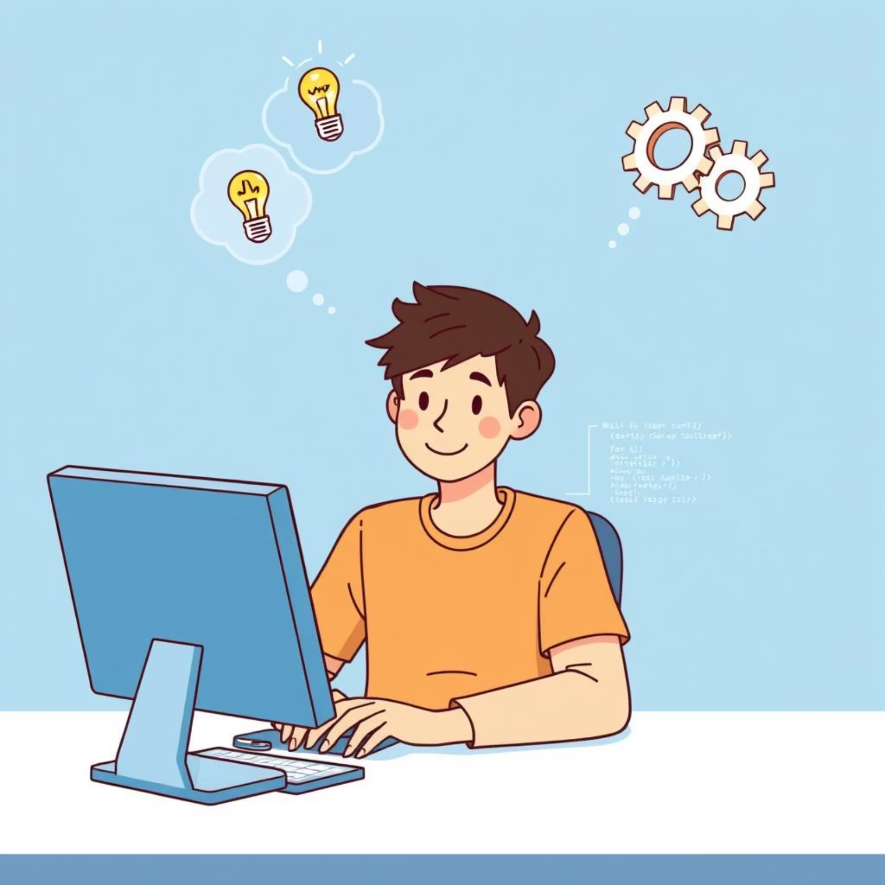
Conclusion: Learning Through Play
This hand cricket project stands as a testament to the power of project-based learning. It highlights how developing a simple GUI game can significantly strengthen foundational programming skills, especially in Python and Tkinter. The journey from concept to a playable game offers invaluable insights into game logic, event handling, and user interface design.
We encourage you to use this project as a springboard for your own innovations. Experiment with new features, refine existing ones, or even explore entirely new game ideas. The possibilities are endless when you combine creativity with code.

Slide 11
Thank you
for
your attention

